Slide 1



Insurance Classification Machine Learning 1 - Project
Wojciech Hrycenko Cezary Kuźmowicz
473173 473169

Slide 2
TABLE OF CONTENTS
01
02
03
04
05
General Informations
Exploratory Data Analysis
Feature Engineering
Modeling
Predictions

Slide 3


General Information
Our task was to apply various ML algorithms to build a model explaining travel insurance claim outcomes based on the training sample and generate predictions for all observations from the test sample.

Slide 4
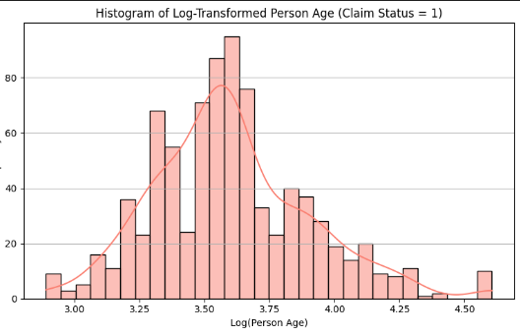
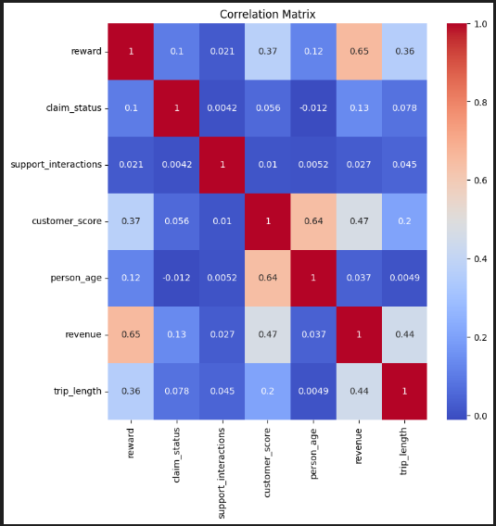
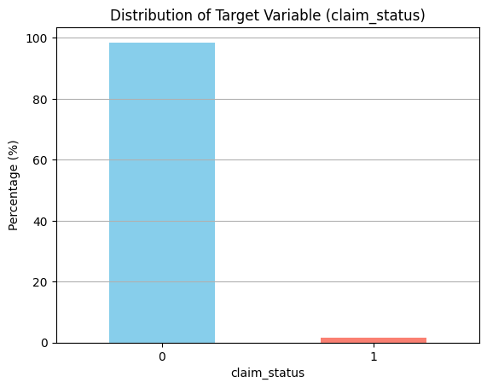
Exploratory Data Analysis
Highly imbalanced target variable
Separated plotting for claim_status 1 & 0
Weak correlations with claim status
Skewed Distributions
Outliers
Need of logaritmisation

Slide 5


Training Data Division
The model has enough data to learn effectively.
70%
Training
For training
15%
Validation
For tuning model parameters.
15%
Test
For final model evaluation
Evaluation is fair and unbiased.
Model is more likely to generalize well to new, unseen data.

Slide 6
Feature Engineering
Create a safe log transformation pipeline that handles negative values and applies scaling
Create a target encoding pipeline for categorical features
Fit the complete preprocessor on training data (X_train, y_train)
Calculate feature indices for SMOTE-NC:
Determine the position of target-encoded (categorical) features in the transformed dataset
Define Transformation Pipelines
Fit and Index Tracking
Feature Grouping and Preparation
Combine into a ColumnTransformer
Identify numerical features for log transformation
Identify categorical features with high cardinality for target encoding
Use ColumnTransformer to apply:
Log pipeline to selected numeric features
Target encoding pipeline to selected categorical features

Slide 7
Feature Engineering
Preprocessing steps (e.g., log transform, target encoding),
SMOTENC to balance the dataset by oversampling the minority class, respecting categorical features,
The chosen classifier model (e.g., Logistic Regression, etc.).
Define the Modeling Pipeline
GridSearchCV Set:
Parameter grid (param_grid) with proper prefix (classifier__)
Scoring metric: balanced_accuracy (to handle class imbalance)
7-fold cross-validation
Parallel processing (n_jobs=-1)
Grid Search for Hyperparameter Tuning
Fit the full pipeline (preprocessing + SMOTE + classifier) with cross-validation
During this step, both hyperparameter tuning and class balancing are handled automatically within each fold.
Train and Tune the Model
Predict on the validation set (X_val)
Calculate and print the balanced accuracy score
Display the best parameters found by GridSearch
Return the best estimator for further use or testing
Evaluate and Return the Best Model

Slide 8
Modelling
Logistic Regression
KNN
SVM
Balanced Class Weights
Many Regularisation Possibilities
Many solvers tested
Various n number, weights, distance metrics, p, algorythm
Various kernels and C Values, Balanced Class Weight

Slide 9
Best Model Results on Validation Set
0,7996
0,7882
0,6930
Logistic Regression
SVM
KNN
Solver: ’lbfgs’
C = 0.1
Class Weight: 'Balanced’
Solver: ’linear’
C = 0.2
Class Weight: 'Balanced’
Classifier Algorithm: 'auto', Classifier Metric: 'minkowski', Classifier n Neighbors: 19, Classifier p: 1,
Classifier Weights': 'uniform'

Slide 10
Why We Chose Logistic Regression
Best Balanced Accuracy and most of other metrics (for ex. AUC and Recall for positive class)
Efficiency and stability

Slide 11
0,7996
0,752
0,7354
Balanced Accuracy of Logistic Regression on Validation Set (Trained on 70% of Insurance Train CSV)
Balanced Accuracy of Logistic Regression on Training Set (Trained on 70% of Insurance Train CSV)
Balanced Accuracy of Logistic Regression on Test Set (Trained on 85% of Insurance Train CSV)

Slide 12
0,7808
0,7522
0,7783
Balanced Accuracy of Logistic Regression on Validation Set (Trained on 80% of Insurance Train CSV)
Balanced Accuracy of Logistic Regression on Training Set (Trained on 80% of Insurance Train CSV)
Balanced Accuracy of Logistic Regression on Test Set (Trained on 90% of Insurance Train CSV)

Slide 13
~0,73 – 0,77
Expected Balanced Accuracy on insurance_test.csv
We hope to predict better than Polish polling companies ☺

Slide 14
THANK YOU!
DO YOU HAVE ANY QUESTIONS?

